Slide 1
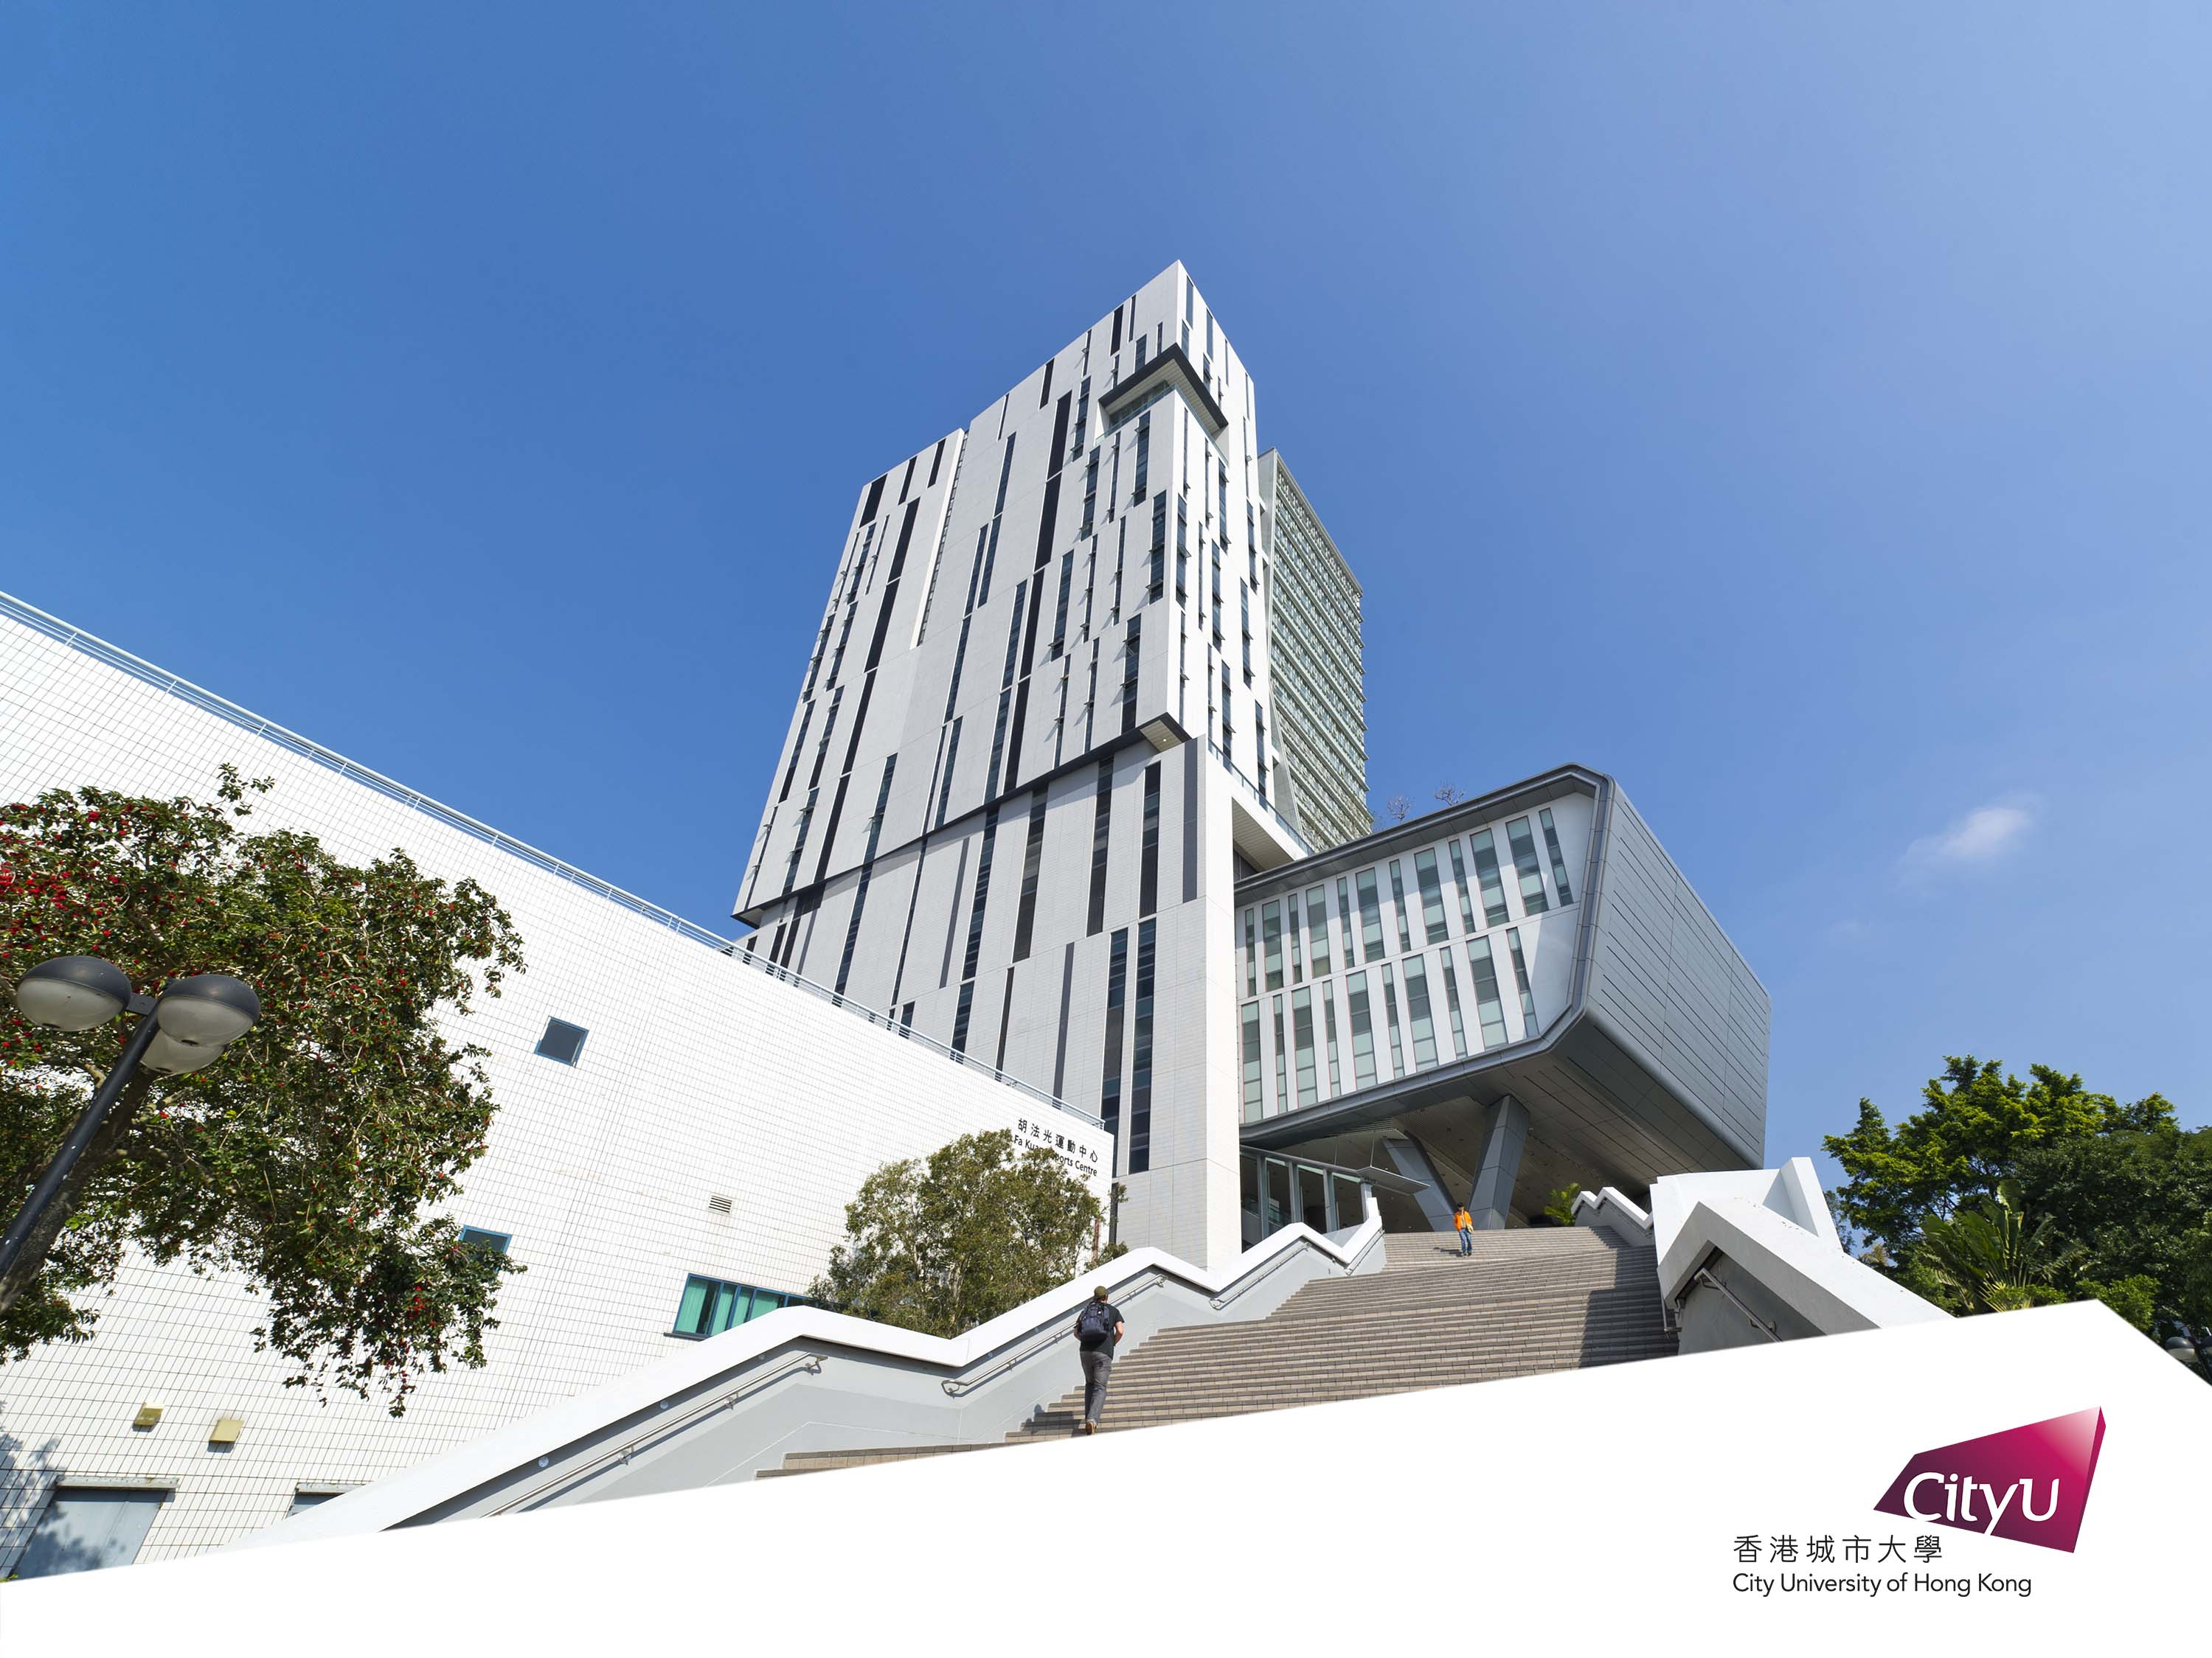
CS5489 Group Project
      Topic: Plant Pathology 2021 - FGVC8
      Group 10:
      Huajun SHEN, SHI Jiansen

Slide 2

Menu
      1. Exploratory Data Analysis
      2. Data Preparation
      3. Create and Train the model
      4. Classify features generated by models
      5. Experiment and Results

Slide 3

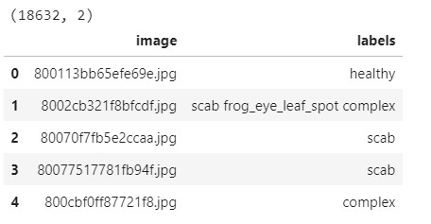


1. Exploratory Data Analysis
      Read and Check
      Firstly, we use pd.dataframe to read the provided csv file, get the image name and related label, and check the content of the csv file to ensure that there are no Null values and special dtype data.

Slide 4
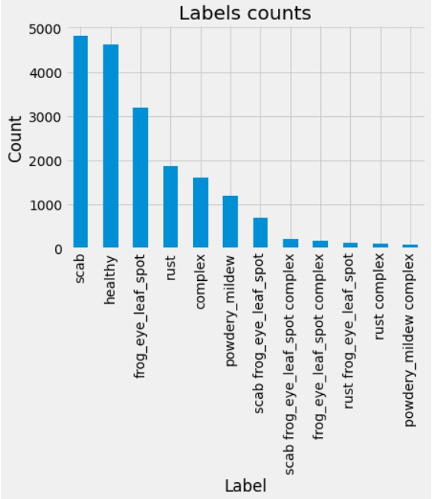
1. Exploratory Data Analysis
      Count and Split Labels
      Then, we counted the number of labels appearing in the data. Because of the presence of composite labels, we need to segment the labels to obtain a single label. It is easy for us to find that there is an obvious imbalance in the data distribution, so we will use F1-Score and set thresholds to alleviate the impact of data imbalance in the future.

Slide 5
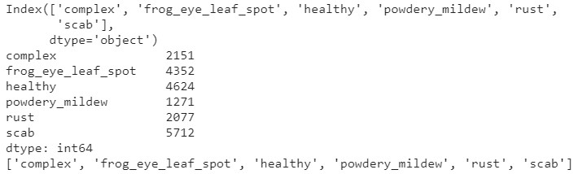
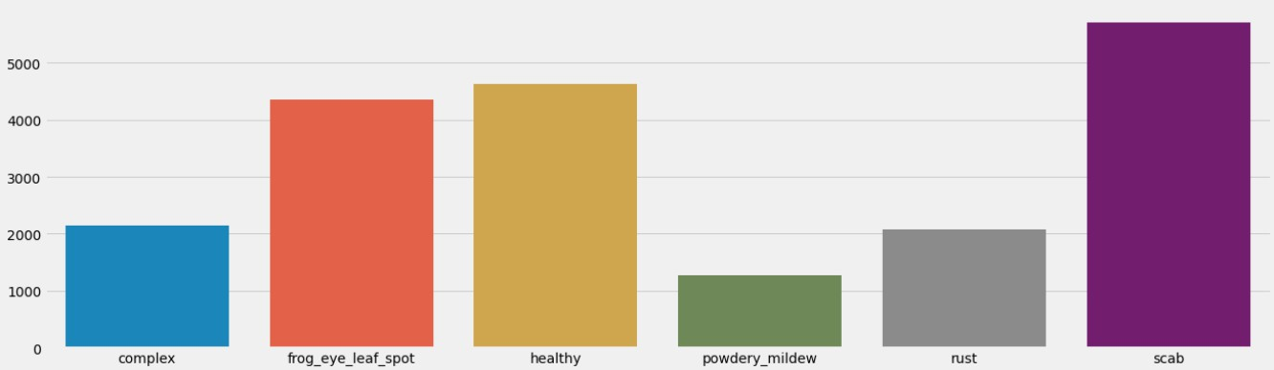
1. Exploratory Data Analysis
The results obtained after spliting are as follows:

Slide 6
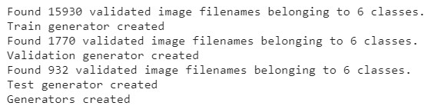
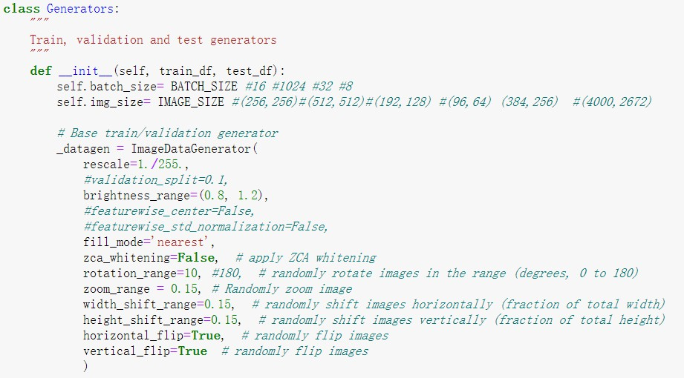
2. Data Preparation
      Create image generator
      Due to the large size of the original pictures in the data set, these pictures are difficult to directly invest in the subsequent model training, so they need to be preprocessed. We define the Generators class, which contains a base ImageDataGenerator for simple data augmentation, and three inherited ImageDataGenerators to generate our training set, validation set and test set through the flow_from_dataframe().

Slide 7
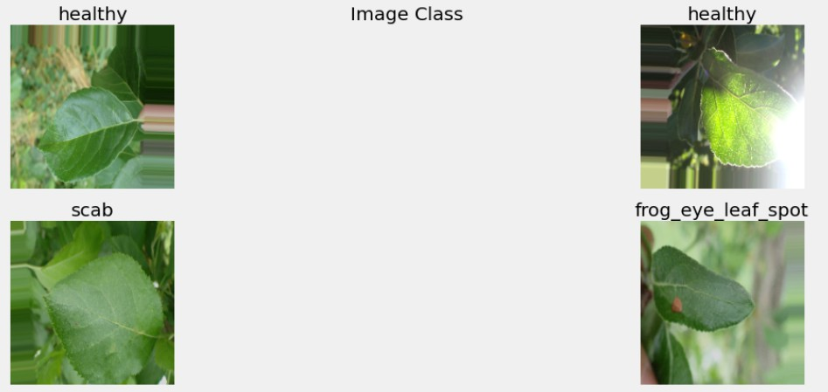
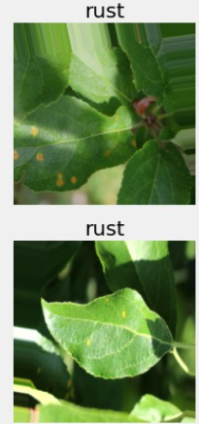
2. Data Preparation
The following are some pictures after preprocessing:

Slide 8
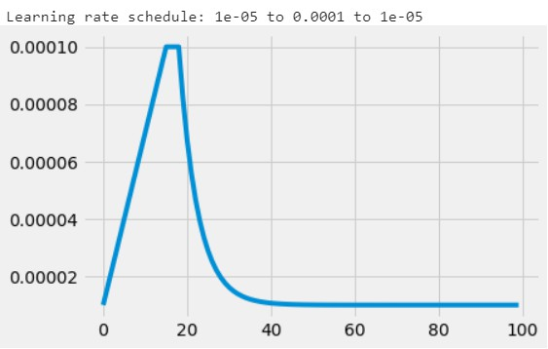
3. Create and Train the model
      Learning rate schedule
      Before entering the training, we first formulated a learning rate schedule, the learning rate will linearly increase to the maximum within 15 epochs, and maintain 3 epochs, and then exponentially decay to the minimum.

Slide 9
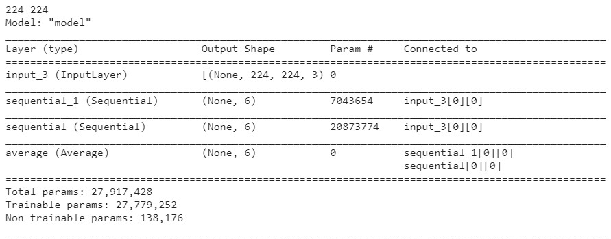
3. Create and Train the model
      Build different models
      We created the ModelTrainer class, in which various models were created in the form of functions to facilitate subsequent calls and comparisons. In addition to creating our own neural network, we also use transfer learning to improve accuracy. The pre-training models we mainly use are EfficientNetB7, Xception, DenseNet121, InceptionResNetV2, ResNet50V2 and VGG16. We also tried model fusion in the process of transfer learning.

Slide 10
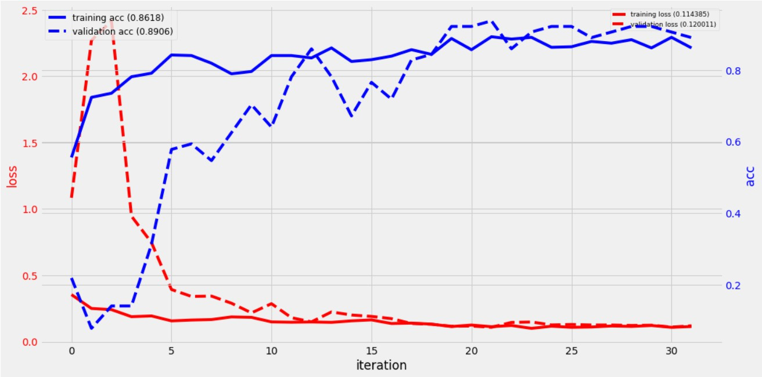
3. Create and Train the model
      Train different models
      The following is the training process of our fused model on Kaggle:

Slide 11
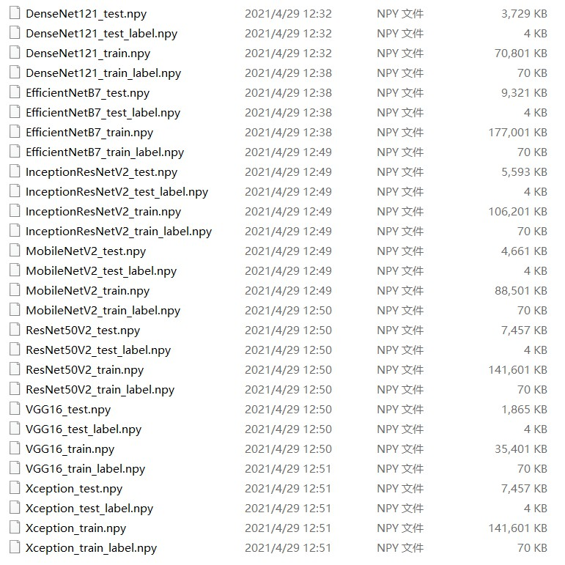
4. Classify features generated by models
      Get the features
      By using the transfer learning method, we have obtained good results, but because the training process is time-consuming, we hope to extract the features of the picture through the pre-training model, and try the fusion of the features in order to get some enlightening results.

Slide 12
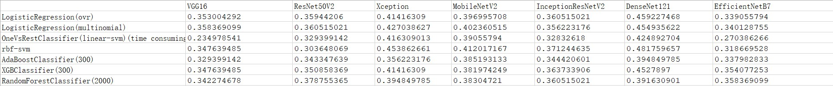
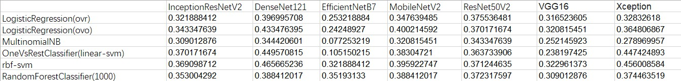
4. Classify features generated by models
      Classify the features
      For the obtained features, we try to use the RAPIDS cuml library in the gpu environment and the sklearn library in the cpu environment to implement traditional linear and nonlinear classifiers. The main ones used are LogisticRegression, Linear-Svm, RBF-Svm, AdaBoost , XGBoost and RandomForest.

Slide 13
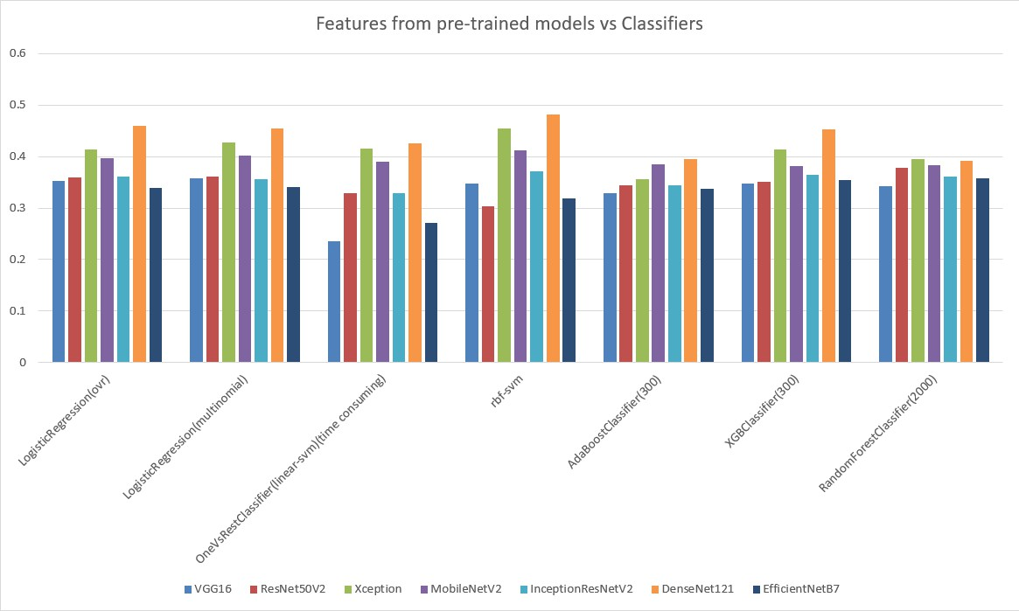
4. Classify features generated by models
      The following are the results in two environments:

Slide 14
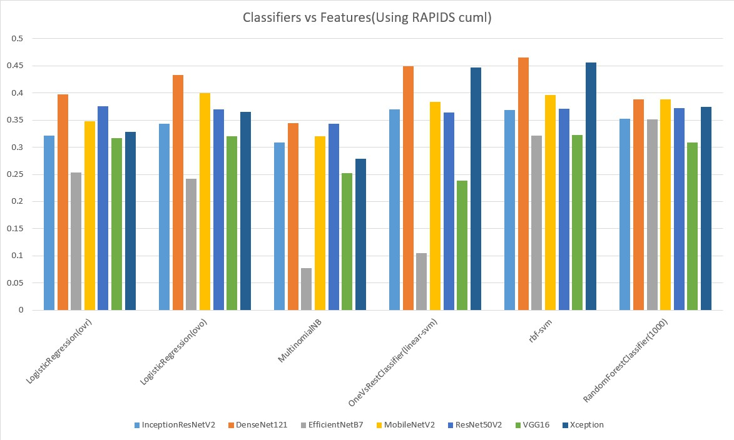
4. Classify features generated by models
      The following are the results in two environments:

Slide 15
4. Classify features generated by models
      Features concatenated + PCA
      Finally, we tried to mix the features extracted from different models. We first concatenated the features of multiple models, and then use PCA to get the most important features from them. Although the improvement is not big in the result, it is possible to continue to improve when the features are sufficient and diverse. And the parameters of the classifier can also be adjusted continuously to achieve better results.

Slide 16
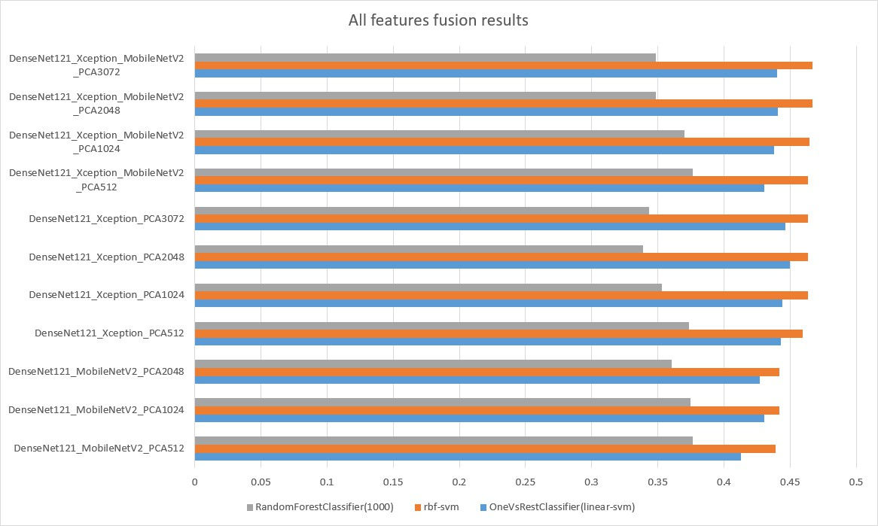
4. Classify features generated by models
      In view of the performance of the previous models, we finally chose the features of DenseNet121, Xception and MobileNetV2 for concatenating. The specific results are as follows:

Slide 17
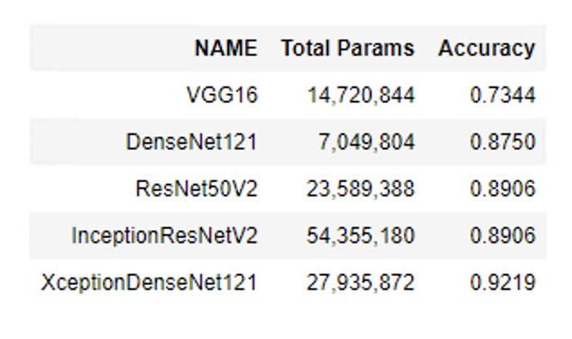
5. Experiment and Results
      This project has tried many pretrained models, results and code list below. From the table, we can see XceptionDenseNet121 receives the best accuracy 0.9219. This model combines Xception and DenseNet121 together, uses these 2 pre-trained network as feature extractors, removes the last layer (the classifier), adds global average pooling layer and classification layer. Then at last,this model averages the output of the combined two models.

Slide 18
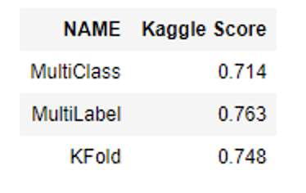
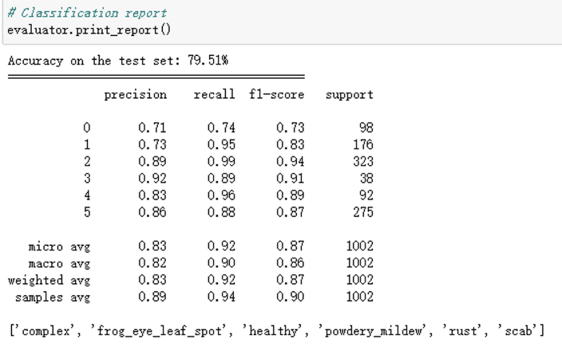
5. Experiment and Results
      After determining the target model, we also tried several different classification methods. In the end, Multilabel won. The best result is shown on the right.

Slide 19

Thank You!

